Slide 1
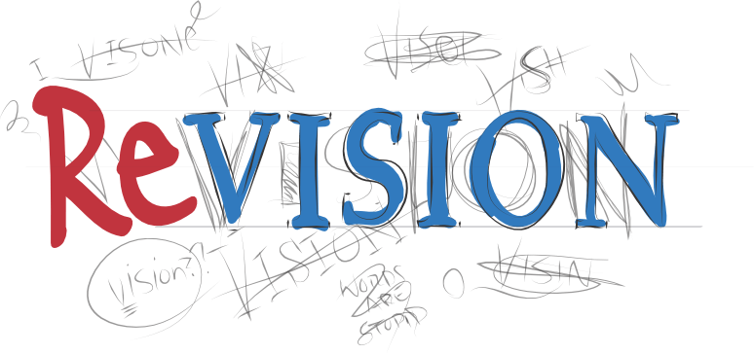
Revision Techniques
Here are some hints and tips

Slide 2
Different ways to revise:
Reading
Making notes
Checklists
RAG rating
Revision cards
Mnemonics
Association
Record Information
Example questions and answers
Past paper questions
‘Revise, test, analyse’
Mind Map

Slide 3
What type of learner are you?
Visual learner | Auditory learner | Reader and writer | Active learner
rewrite your notes as mind-maps use colour to highlight important facts draw diagrams and sketches to help you remember points | read your notes aloud record yourself reading key points aloud to listen back to revise in groups try singing the key points and associate them with a tune | copy out your notes again read over old notes rewrite key points using different phrases try to write key points from memory, and test yourself | move around the room or carry out an activity as you revise mentally test yourself while you are exercising to see what you can remember

Slide 4
Mind Map
Start at the centre with the page with a circle or square (‘central node’) indicating the main topic.
The main ideas that make up the topic should be represented by thick branches that emanate from the central node. Your branches should have one word or two for the purpose of clarity. Think of each branch as a heading in an essay or a book.
Create smaller sub-branches which extend out from every branch. Think of these as sub-headings.
At the end of each branch, write out one key word or concept. This will make it easier to remember key concepts during revision.
Find images or pictures which illustrate your ideas and paste them onto key areas in your diagram.
Try to find connections between the various branches and sub-branches; this is a crucial aspect of critical thinking.
Use colours and pictures ….

Slide 5
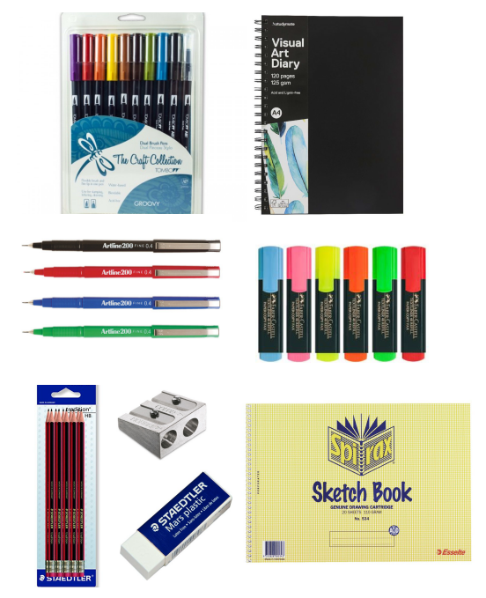
Set yourself up …

Slide 6
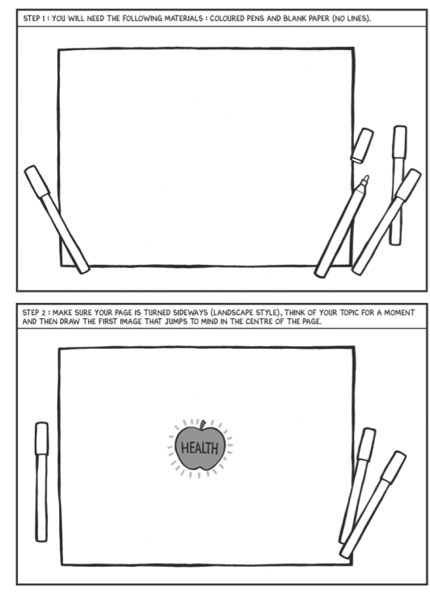

Slide 7
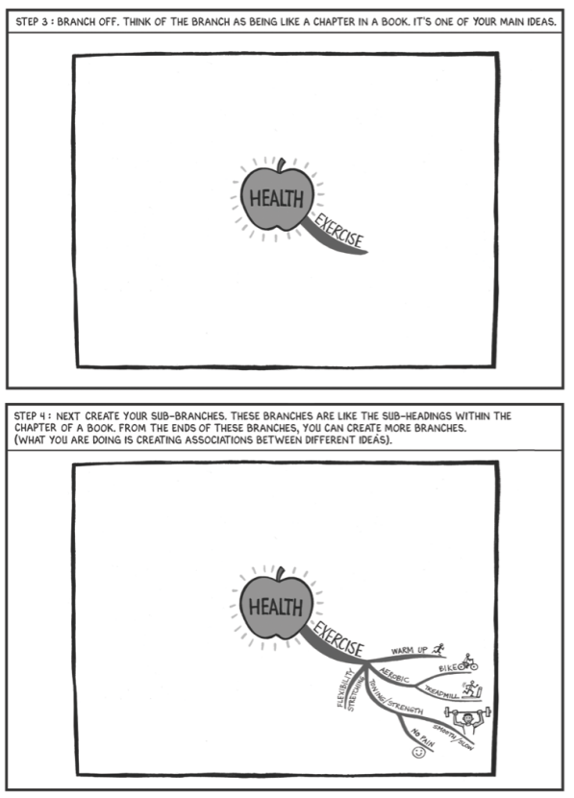

Slide 8
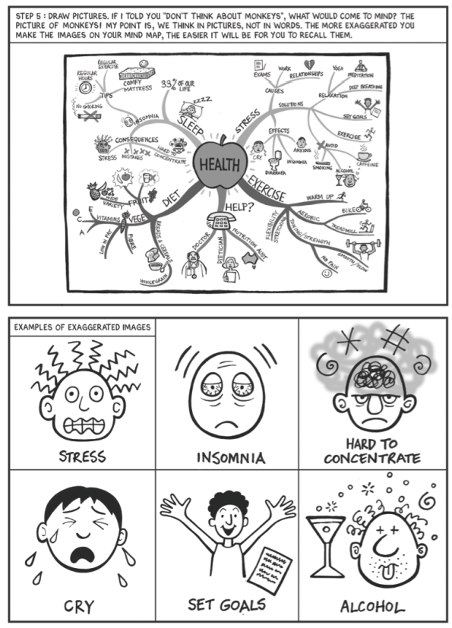

Slide 9
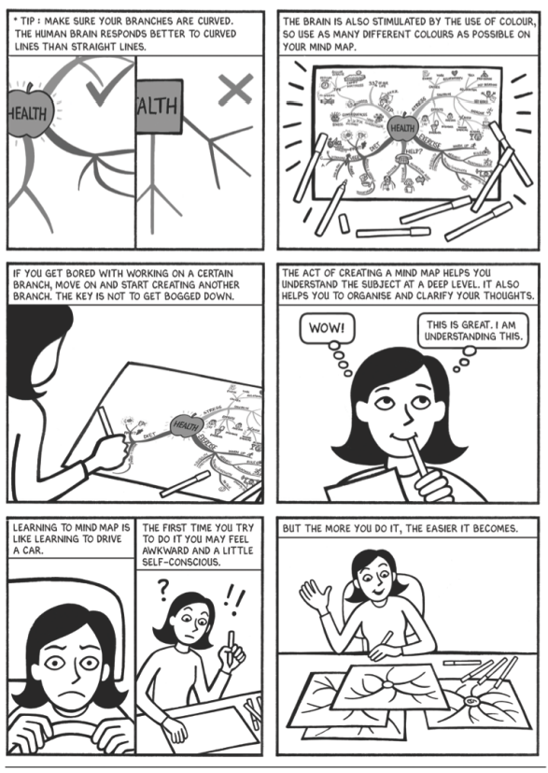

Slide 10
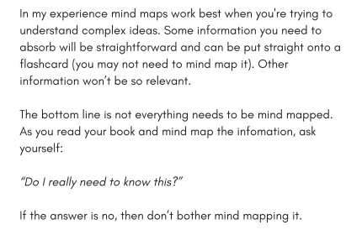
Only mind map the ‘good’ stuff …

Slide 11
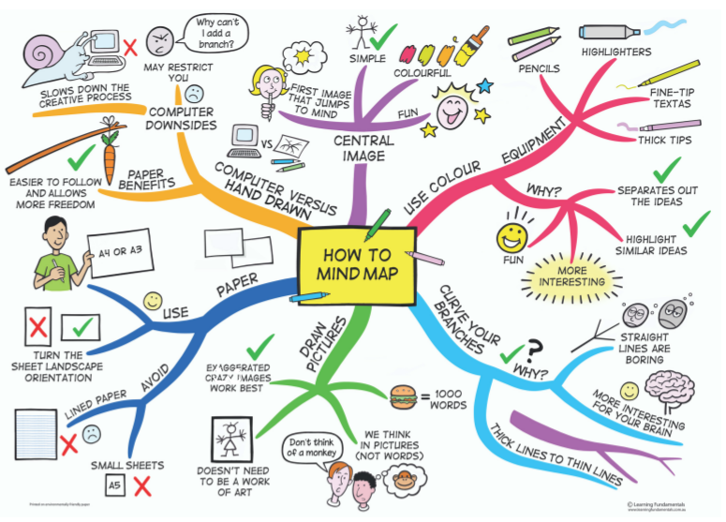

Slide 12
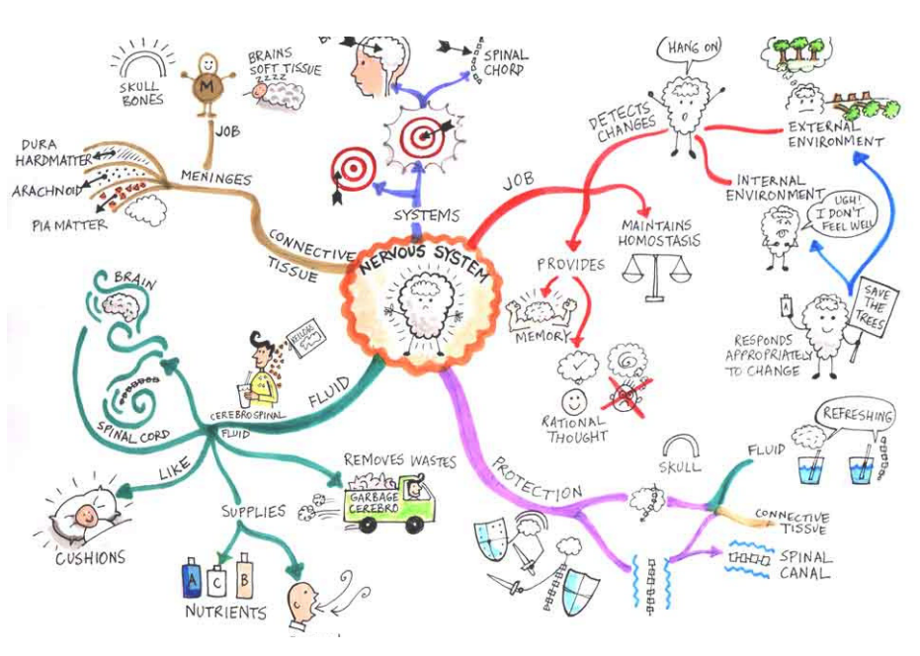

Slide 13
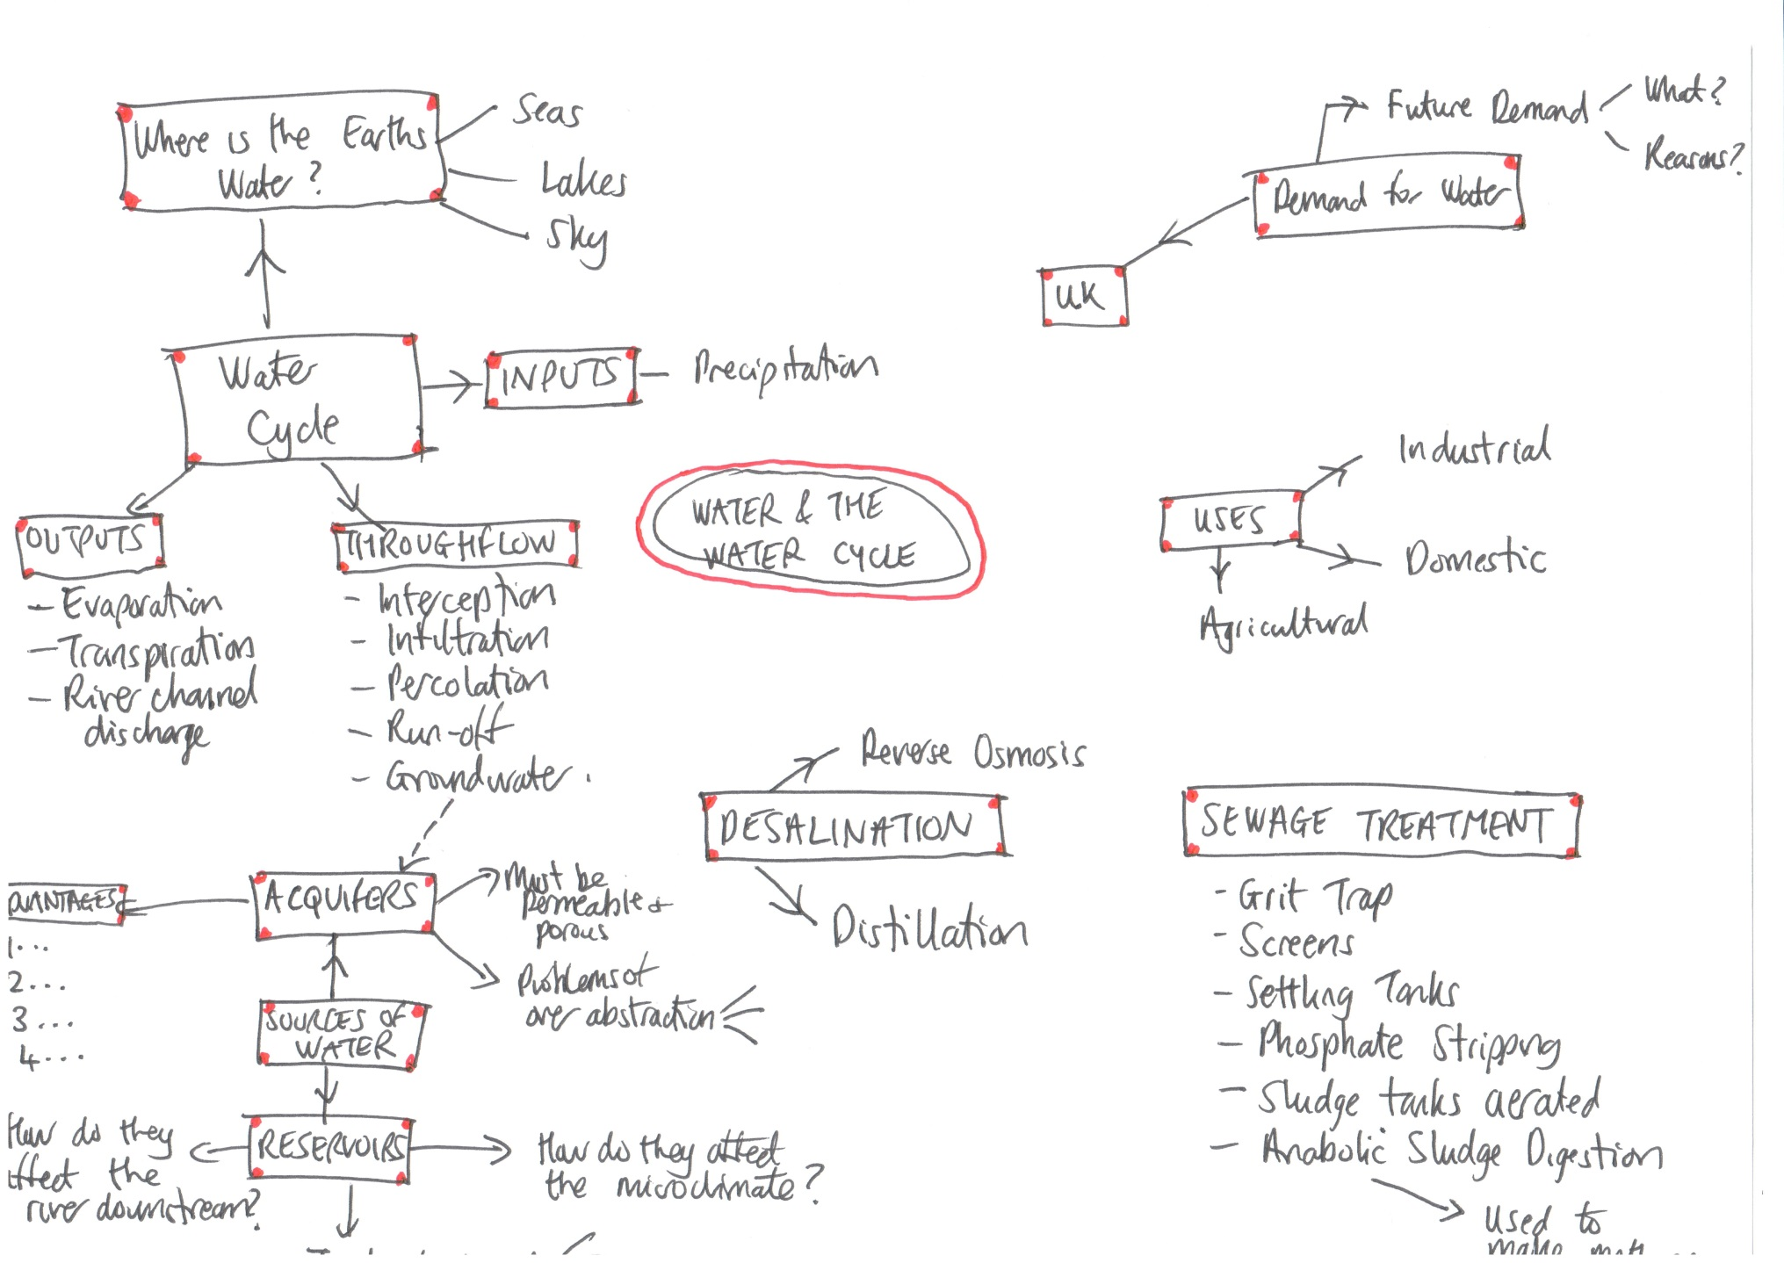

Slide 14
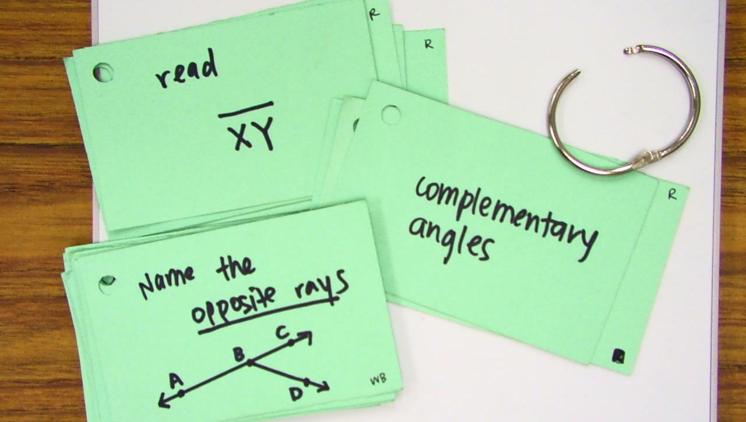
Flash cards
Make them and then test yourself

Slide 15
Mnemonics
Do the Geographers know what this stands for?
Can be a helpful way to memorise facts. The first letter is used to create a phrase or word that you can more easily remember.
For example, Richard Of York Gave Battle In Vain (colours of the rainbow in order: Red, Orange, Yellow, Green, Blue, Indigo, Violet).
C
C
A
S
H

Slide 16
Association
Some students find it helpful to associate sounds or images with the information they are learning or to use notes / mind maps as a visual memory trigger.

Slide 17
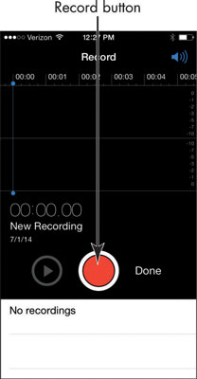
Record Information …
…. That you need to remember and then you can play it back to yourself

Slide 18
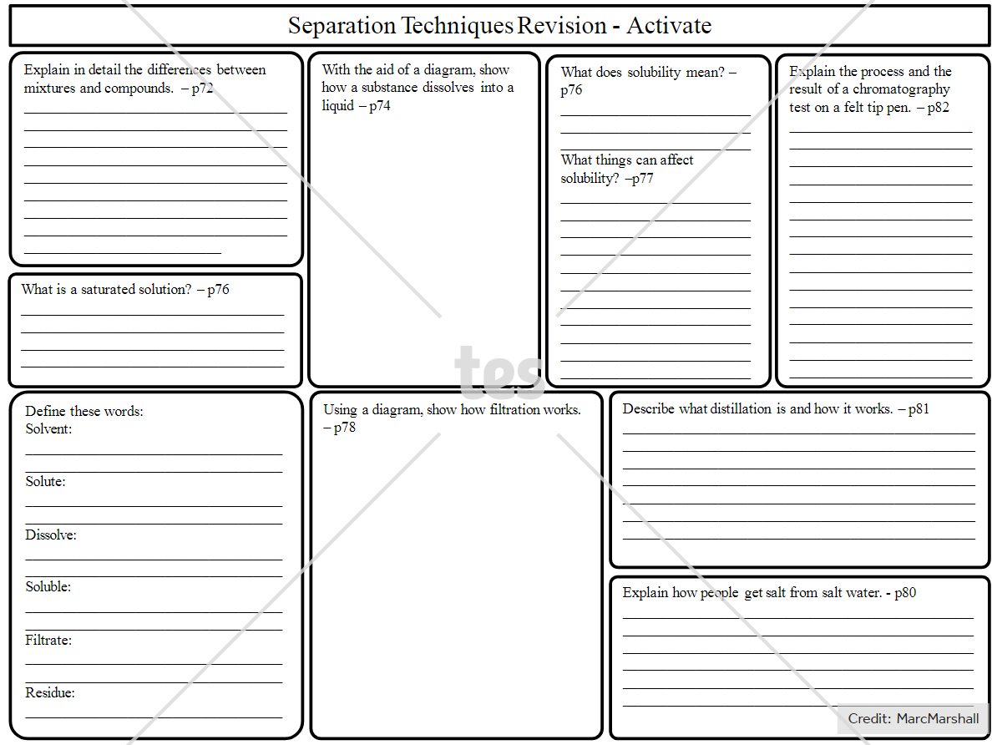
A3 sheet

Slide 19
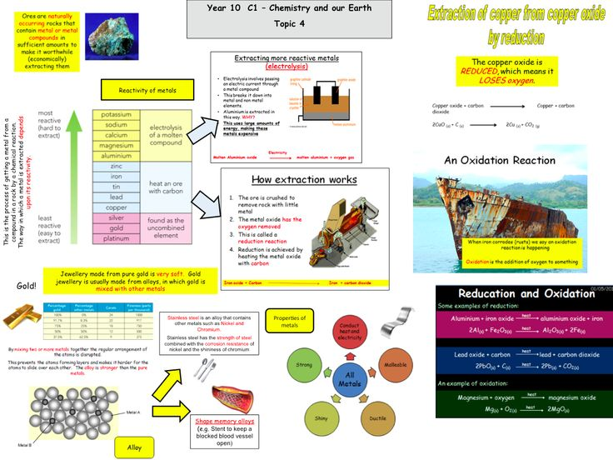

Slide 20
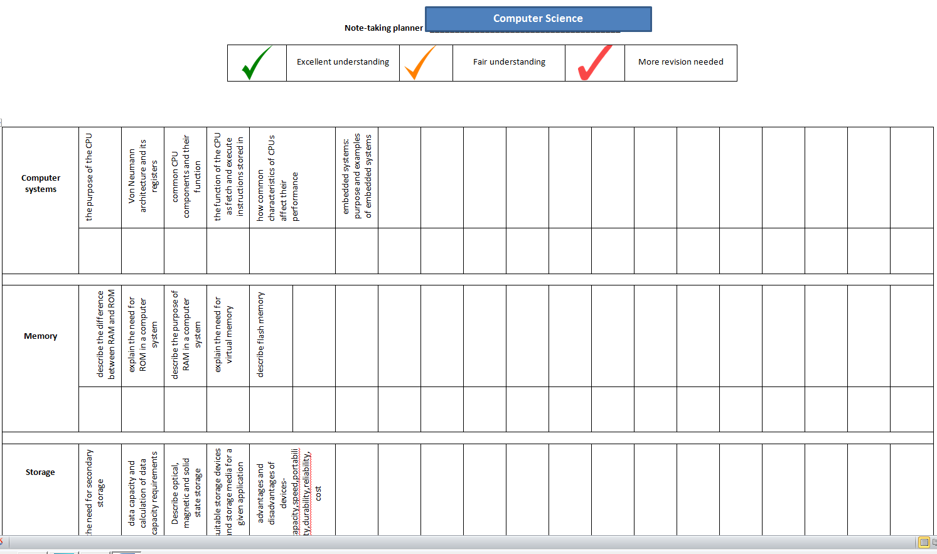
RAG rating

Slide 21
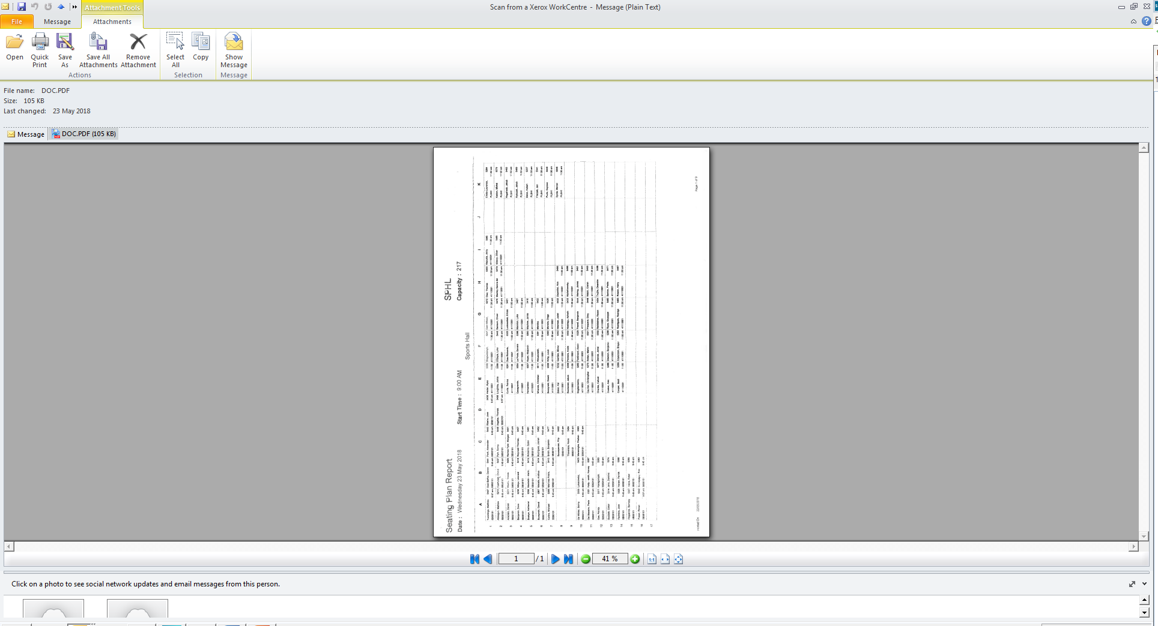
Seating Plan

Slide 22
Seating Plan

