Slide 1

Grammar Work Experience
12th January 2026

Slide 2

Grammar Work Experience
Why Work Experience?
Key dates
Finding a placement
Health and Safety
Getting ready for the first day
Work Experience week
After Work Experience

Slide 3
Why Work Experience?
To give your son a taste of the world of work
To allow him to try out career aspirations he may have
To experience first-hand the expectations and demands of the workplace
To focus his mind on what he then needs to do in school to gain access to his chosen career
Enjoyable and rewarding

Slide 4
Key Dates 2026
Meeting for Parents Monday 12th January
Assembly for Boys Start of Spring Term
Agreement Forms deadline Friday 8th May
Pre-Visit to Workplace May half-term (advised)
Work Experience Week Monday 6th –Friday 10th July
Boys return to school Monday 13th July

Slide 5
Finding a Placement
How do I find a placement?
Ms Parrish is available in the careers room Tuesday 3.10-4.00pm
What if I can’t find a placement?
Can you help someone else?
Can I extend work experience?

Slide 6
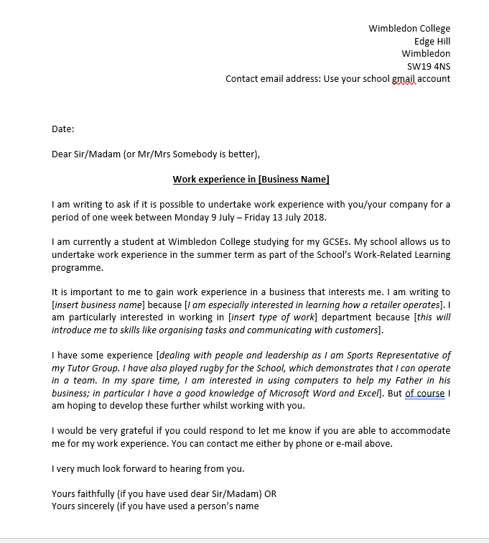
Writing to the company
Draft found in the Work Experience booklet
Please do not give personal email or phone number out

Slide 7
Work Experience In The Past
Primary Schools
TFL
Fulham Football Club
HSBC Bank
Marks & Spencer
BT
Network Rail
Kings College Hospital
British Transport Police
Titan Sports Academy
City Hall
Wimbledon Golf Club

Slide 8
Health and Safety
Insurance
Employers Liability Insurance Policy
(Public Liability Insurance)
Child Protection
Work Experience Agreement Form

Slide 9
Things to consider
Is the person a sole trader?
Is the experience safe?
Do they have a risk assessment?
Do I need to make the employer aware of any information about my son?
Parental checklist in the booklet
All placements are agreed at the Headteacher’s discretion

Slide 10
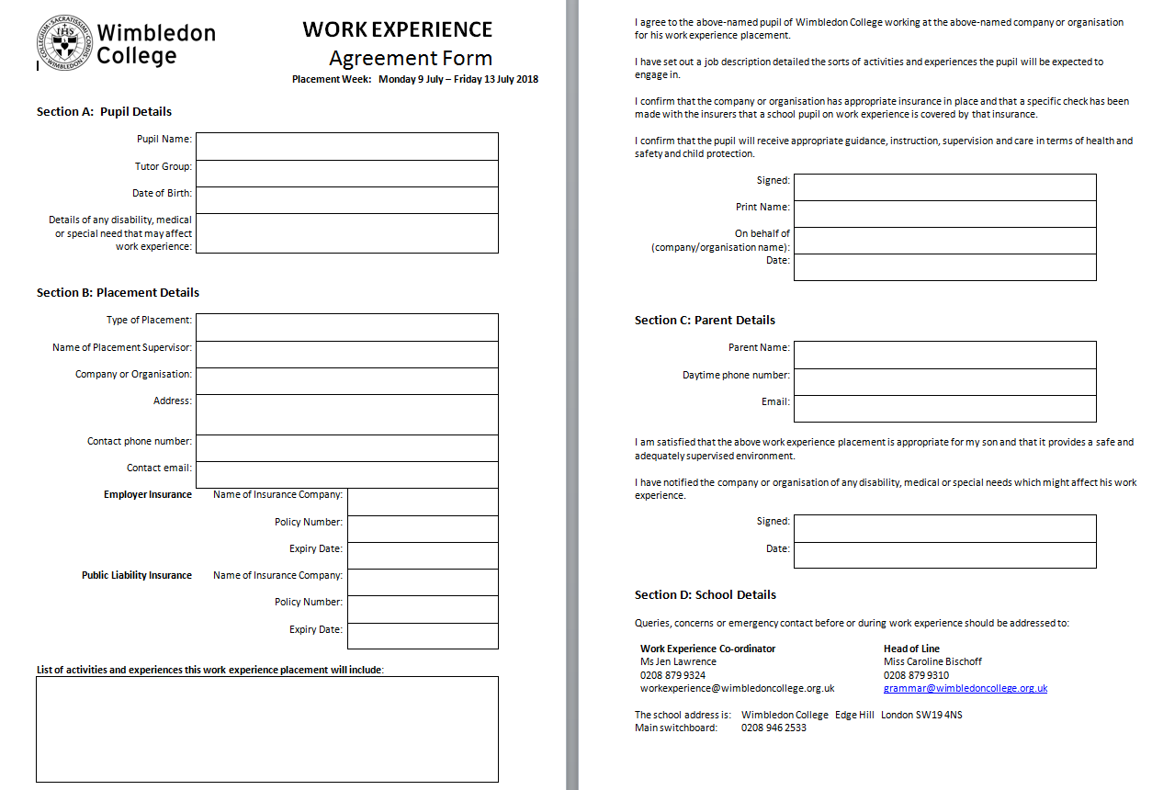
The ‘blue’ form

Slide 11
Planning for Work experience
Pre-placement day
Arrange an appointment well in advance with the placement provider
May half-term would be a good time to visit

Slide 12
Work Experience Week
Before Work Experience Week
Checklist (in the booklet)
During Work Experience week
General queries
christopher.cole@wimbledoncollege.org.uk
Safegaurding
safe@wimbledoncollege.org.uk

Slide 13
After Work Experience
Evaluation and reflection of the week
Thanking people

Slide 14
Pupil Engagement
Pupils should be proactive and engage in this process, to identify their aspirations
All students have Unifrog accounts where they can search in more depth about career choices

Slide 15
Where can I find this information?
Work Experience pages on website
Final reminder:
Agreement Forms deadline Friday 8th May 2026

Slide 16


